Slide 1
Docker Compose Review
November, 2019

Slide 2
Docker Compose Drivers
New Projects
Forward propagated cache
Batch framework
Process
Deployment
CI/CD
Local development

Slide 3
Selection Process Phase 2
90 minute vendor presentations with optional demo
9 comparison dimensions
6 member DDMI review team
Optional sandbox environments
Simple average of scores
Recommendation: Canonical

Slide 4
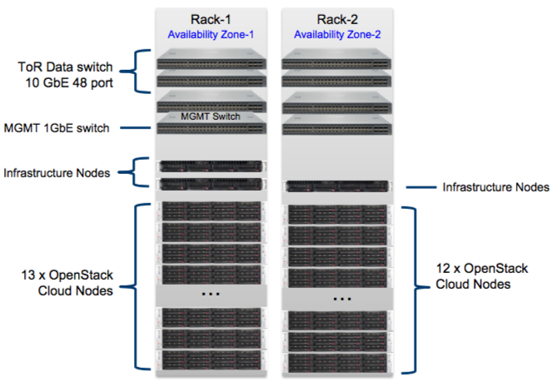
Canonical Summary
Hardware (Supermicro)
3 Infrastructure Nodes
16 cores / 256GB RAM
800GB NVMe / 24TB HDD
12 Cloud Nodes
40 cores / 768GB RAM
800GB NVMe / 48TB HDD (576TB RAW)
13 Storage Nodes
40 cores / 64GB RAM
800GB NVMe / 48TB HDD (624TB RAW)
Aggregate 1.2PB RAW ~900TB usable / triple write => 300TB usable
2 TOR data switches
2 TOR mgt switches
Dual Rack configuration
Services
Delivered from US (San Antonio, TX)
Access restricted to control plane layer for managing the undercloud
Assigned account mgr and Technical lead with support team
includes Ubuntu O/S licenses (requires security hardening)
Approach
Procure 3 private cloud appliances (estimated $4.5M over 3 years)
Production (Okemos)
Non-Production (Okemos)
Disaster Recovery (Farmington Hills)
Distribute Roosevelt environments across 3 appliances
PROD: Prod
Non-PROD: Test, UAT, Pre-PROD, Dev
DR: Disaster Recovery
Implementation timeline (April – May)
4-6 week order and build
1 week ship / install
3-5 weeks Foundation cloud build

Slide 5
Next Steps
Complete ARB Review
Finalize Security impact assessment (1/29)
Notify Canonical
Purchasing conduct final negotiations (2/2018)
Legal and Business review and approval
Finalize Appliance BOMs and Architecture / environment placement (2/2018)
Target first installations (4/15-5/15)

